Slide 1
DO-NOW
Level 0
Voice!
SILENTLY take a seat
Immediately begin your do now
RAISE your hand silently if you have a question
FINISH THE SENTENCE
If I had a superpower, it would be ______________________.

Slide 2
ANNOUNCEMENTS
Level 0
Voice!
Parent Questionnaire due tomorrow!
(+10 points)
Group quiz

Slide 3
HOW DO WE ENTER THE CLASSROOM?
Level 0
Voice!
Voice level 0. If you have a question for Ms. Zamora, raise your hand.
Immediately take a seat
When the tardy bell rings you are late.
Work on your do now

Slide 4
Why Procedures?
Without procedures, students do not know what is expected of them.
Procedures facilitate efficiency.
Human Nature is to have procedures.

Slide 5
Arrival to Class
When you arrive at our class, I will greet you at the door.
When you enter the classroom please take a seat and begin working on your Do Now.

Slide 6
When Class Begins (Bell)
The bell ringing is a procedure to tell you that it is time to begin class.
At the bell, you are to begin your Do Now exercise. Your warm-up exercise is Journal Writing.
There should be no talking or moving about during Journal Writing.

Slide 7
Arriving Late/Being Tardy
If you are late, you MUST have a note from the office.
Please come into class quietly as to not disturb your classmates.

Slide 8
Class Discussions
One Mic!
(Means only one person talks at a time)

Slide 9
Teacher says
Students say
To infinity….
...and beyond!
Ready, set...
...you bet!
...everybody focus!
Hocus pocus...
Notes:
VLevel 2…
Topics: Would you rather live in a cold climate or hot climate?
What is your favorite holiday?
If you could live anywhere, where would you live?

Slide 10
When you are absent...
Station in the back.
(You are responsible for getting the work you missed.)

Slide 11
Bathroom policy
If you need to use the restroom, fist ask for permission and take a bathroom pass.

Slide 12
GETTING IN LINE
When we are going anywhere as a group, remember you are a representation of our class.

Slide 13
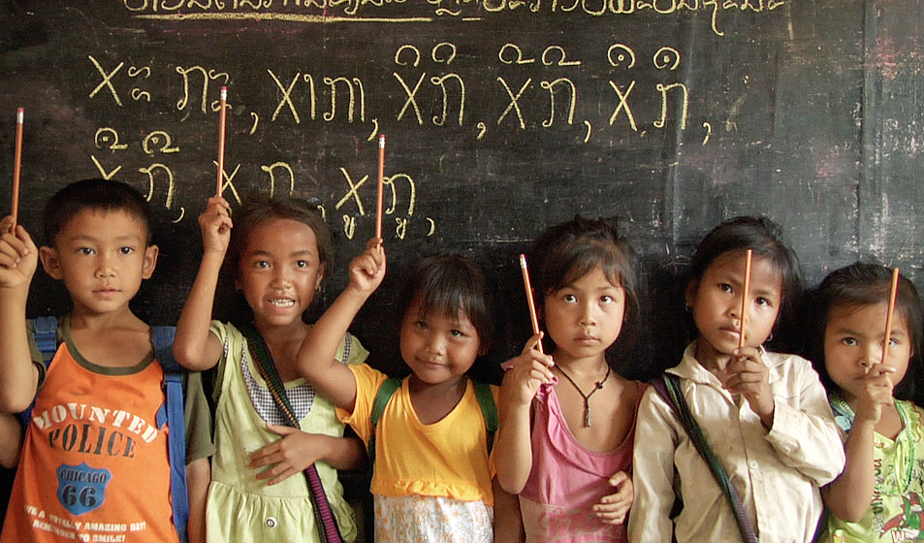
WHAT DOES THAT SIGN MEAN?
Level 0
Voice!
Raise your hand with your pencil in the air | When you need to sharpen your pencil

Slide 14
WHAT DOES THAT SIGN MEAN?
Level 0
Voice!
 | You need to see Ms. Zamora right away!

Slide 15
WHAT DOES THAT SIGN MEAN?
Level 0
Voice!
 | You agree with what was said

Slide 16
WHAT DOES THAT SIGN MEAN?
Level 0
Voice!
 | You disagree with what was said

Slide 17
WHAT DOES THAT SIGN MEAN?
 | Raise your hand if you have a question/comment

Slide 18
HAND SIGNALS PRACTICE
Level 0
Voice!
We will play a game to see which table group can show me the correct hand signal the best

Slide 19
How many tickets do you need to earn to get a reward?
10!!!!

Slide 20
Explain what “Spy talk” is
Speaking softly

Slide 21
What is Voice level 3?
Presenter Voice: Speaking aloud so everyone can hear

Slide 22
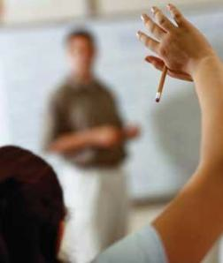
MY PENCIL BROKE, I NEED TO SHARPEN IT
Raise your pencil in the air

Slide 23
YOU NEED TO SEE MS. Zamora RIGHT AWAY

Slide 24
You agree

Slide 25
You disagree

Slide 26
YOU HAVE TO SEE MRS. Zamora RIGHT AWAY!

Slide 27
YOU NEED YOUR PENCIL SHARPENED

Slide 28
YOU AGREE WITH THE STATEMENT

Slide 29
YOU DISAGREE WITH SOMETHING THAT WAS SAID

