Slide 1
Mrs. Ward-Zamora
Livingston Middle School
2016-2017 School Year
Notes:
Do Now: Pick up paper and get started.

Slide 2
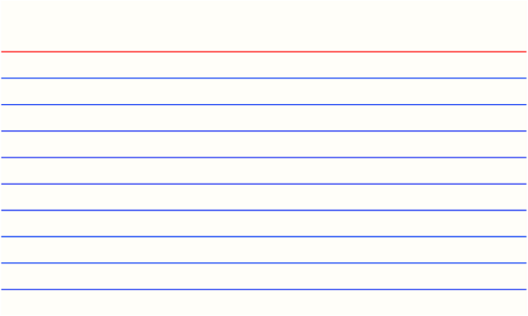
SILENTLY take a seat
Immediately begin your do now
RAISE your hand silently if you have a question
DO NOW
First and Last Name
Is there another name you would like me
to call you? (Nickname)
List all languages you speak
Favorite subject in school
Least favorite subject in school?
What do you want to be when you grow up?
What’s a question you have for
Mrs. Zamora and/or Mrs. Chavez?
Notes:
Practice passing papers to the side

Slide 3
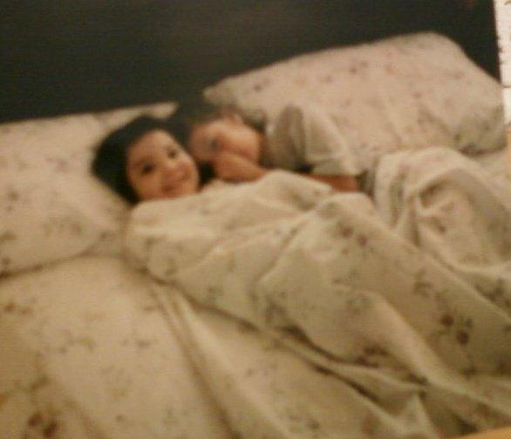
Who is Mrs. Ward-Zamora?
Your Teacher!

Slide 5


Slide 6
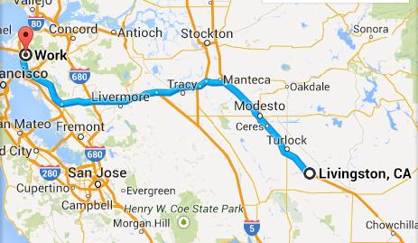
Where is Mrs. Ward-Zamora from?
El Cerrito, Ca
to
Livingston, California
Turn to someone next to you, introduce yourself, and share where you are from!

Slide 7






Slide 8
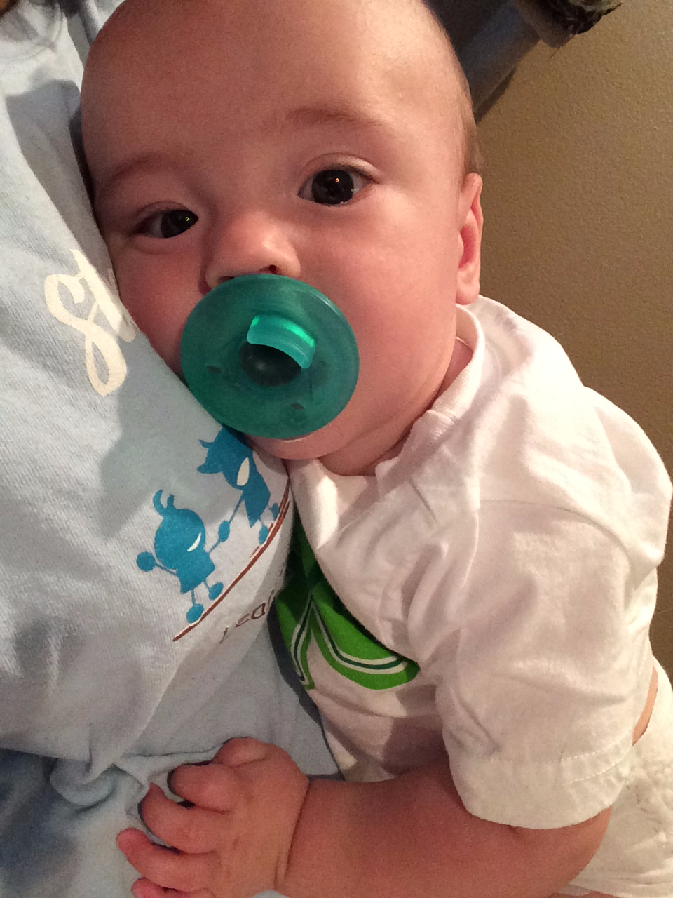
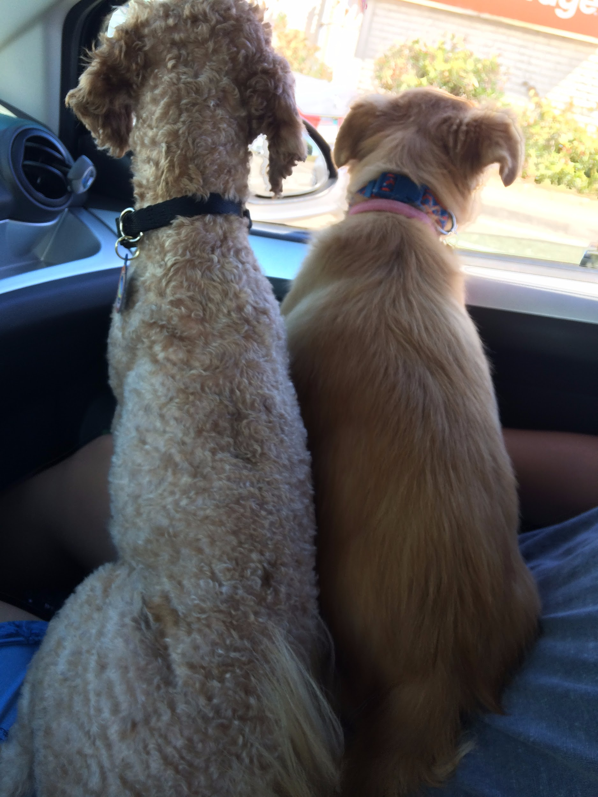

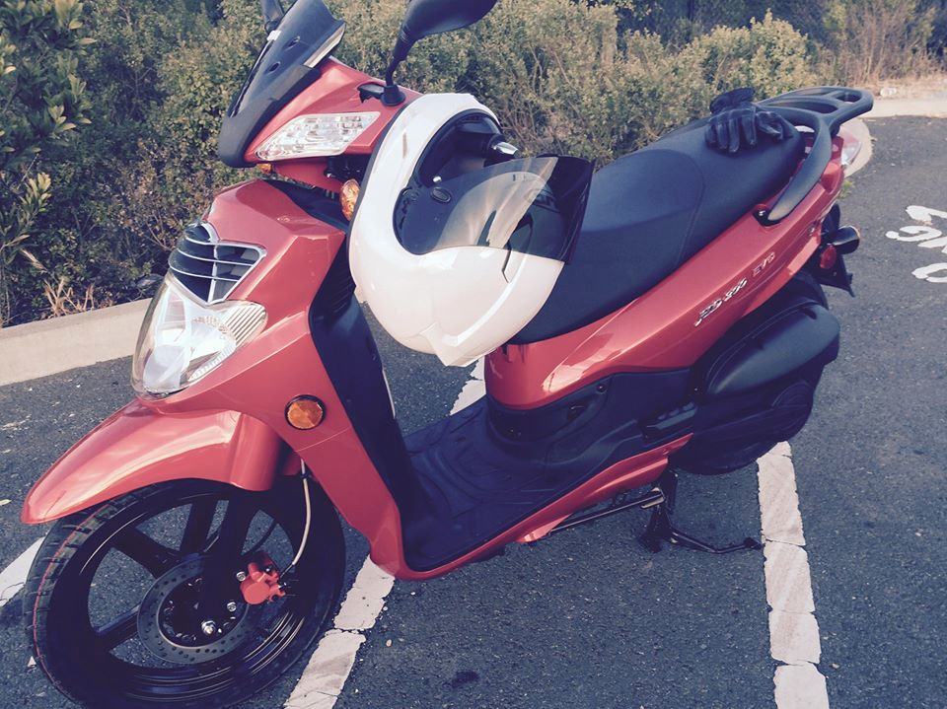

What does Ms. Zamora like to do for fun?

Slide 9
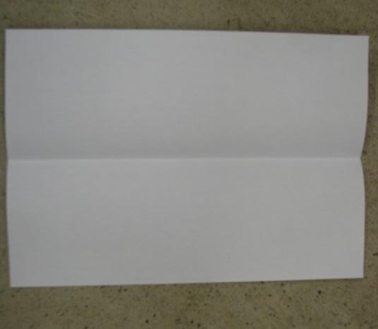
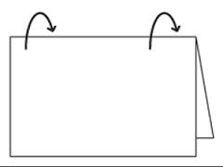
Name Tags

Slide 10
Your favorite color
Number of siblings you have
First and Last Name
Your favorite TV show/movie
Your favorite dessert
Example:
Rainbow
7 siblings
Racquel Ward-Zamora
Fight club
Ice Cream

Slide 11
On the back
Draw/decorate something that makes you happy

Slide 12
Time to Get
to Know One Another!
Notes:
NAME BALL TOSS

Slide 13




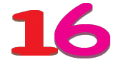

Mrs. Zamora by the Numbers Game
You need a piece of paper.
Number it 1-10

Slide 14
#1
3
The number of times I’ve taught math throughout my career.
The number of schools I have worked at
The number of times I’ve been teaching

Slide 15
#2
Why is this number important to Mrs. Zamora?
4
It’s how many years I have until I retire
It’s how many children I have.
It’s my lucky number

Slide 16
#3
1
The number of years I have taught science.
This is the loneliest number you’ll ever hear
This is the number of dogs I have

Slide 17
#4
6
The number of pairs of shoes I have
The number of Game of Thrones episodes I have watched in one sitting
The number of books I have read

Slide 18
#5
7
The age I was when I got my first car
The number of brothers and sisters I have
The number of times I have been to Disneyland

Slide 19
#6
10
The number of times I played Pokemon Go! This summer
The number of towns I have ever lived in
The number of tattoos I have

Slide 20
#7
3
The number of times I’ve taught math throughout my career.
The number of schools I have worked at
The number of times I’ve been teaching

Slide 21
#8
308
The number of rocks I’ve collected
My old classroom number
The number of times I’ve jumped on a pogo stick.

Slide 22
#9
9.5
My height in centimeters
My address number
My shoe size

Slide 23
#10
24
The number of dishes I can cook
My age
The number of push ups I can do in one sitting

Slide 24
Now it's your turn. Number your paper 1-5. Pick any 5 numbers that are significant to you. It can be serious or funny. But you have to explain each number's importance. You will be turning this into me.
300
  Fun fact here
  Fun fact here
  Fun fact here
--
  -
  -
  -
Notes:
This can be done on a spare sheet of paper. Number on the top, 3 choices below.

